Slide 1
Version Control
劉建宏
台北科大資工系

Slide 2
Problem
Alice, Bob and Catherine cowork in a project
Alice: web page
Bob: application flow
Cathy: database access
They are struggling for the inconsistencies of the source files every day

Slide 3
Problem (continued)
Cathy updates the database schema; it only works on her computer, but not on Alice’s or Bob’s
Bob adds a cool utility function, but the function is gone after syncing with Cathy’s
They all have to remember what is modified by whom at when since last sync to avoid code break

Slide 4
Version Control System
A system for information (source code, of course) sharing and synchronization
You can backup ; you can restore
A repository stores the files
Any number of clients can connect to the server and read/ write the files in the repository
A write from one client creates a new version of the affected files

Slide 5
Usage Patterns
Any client can sync the newer version of the file from the repository

Slide 6
Usage Patterns (continued)
Update history is kept in the repository
Any previous version can be retrieve

Slide 7
Usage Patterns (continued)
Non-overlapping updates to the same file can be made safely
Overlapping updates needs manual resolution

Slide 8
Usage Pattern In-a-nutshell

Slide 9
General Operations
Import
initial addition to the repository to make it versioned
Check-out
make a sync-able copy of the files from the repository
Update
get the updates by others from the repository
Check-in (Commit)
submit your changes to the repository

Slide 10
General Operations (continued)
Add
add new files to the repository
Delete
delete files and propagate to the repository
Can deleted files be restored?
Diff
view your local (uncommitted) changes.
Diff 2 versions in the history?
Revert
discard your local changes
Resolve conflict

Slide 11
Version Control System’s “Versions”
Local only
Open-source: SCCS (1972) · RCS (1982)
Proprietary: PVCS (1985)
Centralized
Open-source: CVS (1990) · CVSNT (1998) · Subversion (2000)
Proprietary: Software Change Manager (1970s) · ClearCase (1992) · Visual SourceSafe (1994) · Perforce (1995) · Team Foundation Server (2005)
Distributed
Open-source: GNU arch (2001) · Darcs (2002) · DCVS (2002) · SVK (2003) · Monotone (2003) · Codeville (2005) · Git (2005) · Mercurial (2005) · Bazaar (2005) · Fossil (2007)
Proprietary: TeamWare (1990s?) · Code Co-op (1997) · BitKeeper (1998) · Plastic SCM (2006)

Slide 12
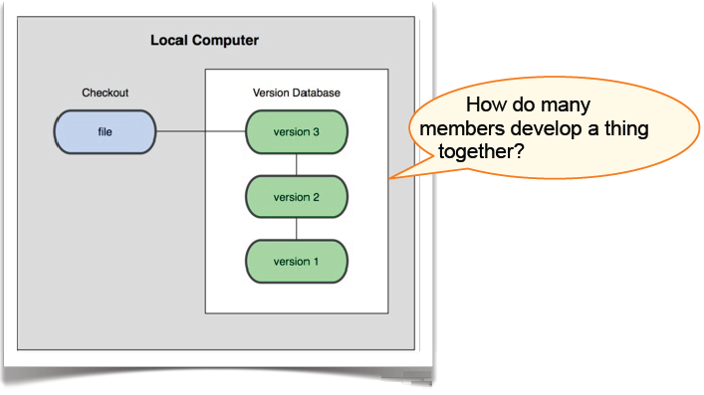
Local VCS
RCS

Slide 13

Centralized VCS
Client-Server: Perforce, SubVersion, CVS

Slide 14
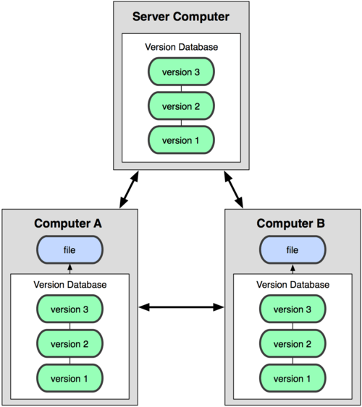
Distributed VCS
Git, Mercurial(Hg), Bazaar

Slide 15
An Adventure of the Storage Model

Slide 16

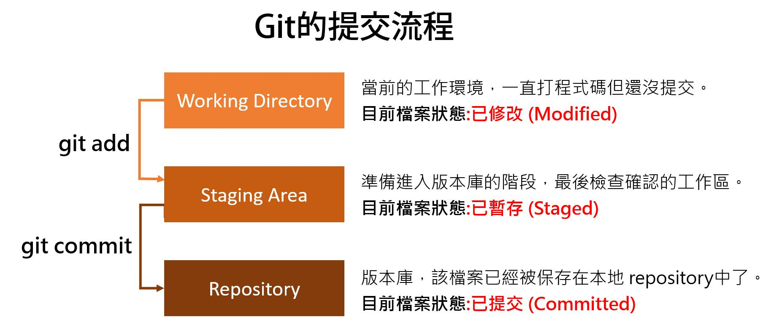
Git
Git中的檔案有三種狀態：已修改、已暫存和已提交，三者分別位於Working Directory (本地端)、Staging Area (暫存端)和Repository (版本庫)
Source: https://hellolynn.hpd.io/2017/01/18/git%E6%96%B0%E6%89%8B%E5%85%A5%E9%96%80%E6%95%99%E5%AD%B8-part-1/

Slide 17
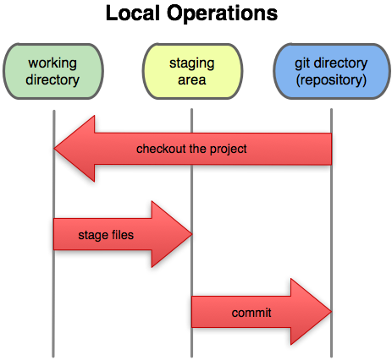
File Stages

Slide 18
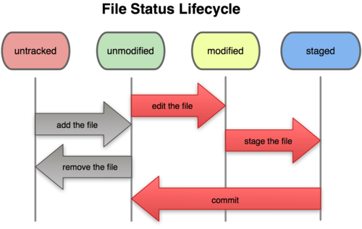
File Stages (continued)

Slide 19
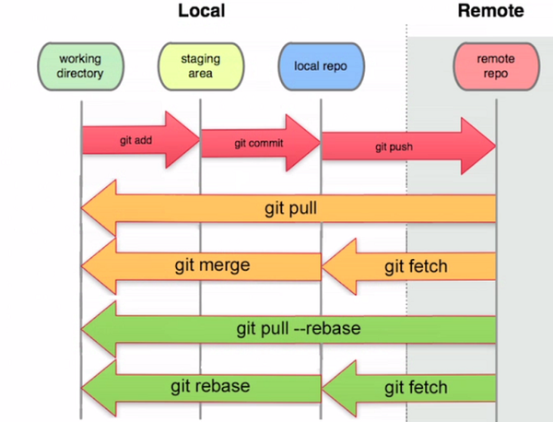
Git stage
Source: https://pic.pimg.tw/silverwind1982/1483082151-1840902919_n.png
Notes:
加上 rebase 的意思是，會先 1.把本地 repo. 從上次 pull 之後的變更暫存起來 2. 回復到上次 pull 時的情況 3. 套用遠端的變更 4. 最後再套用剛暫存下來的本地變更。詳細說明可以參考 pull with rebase。

Slide 20
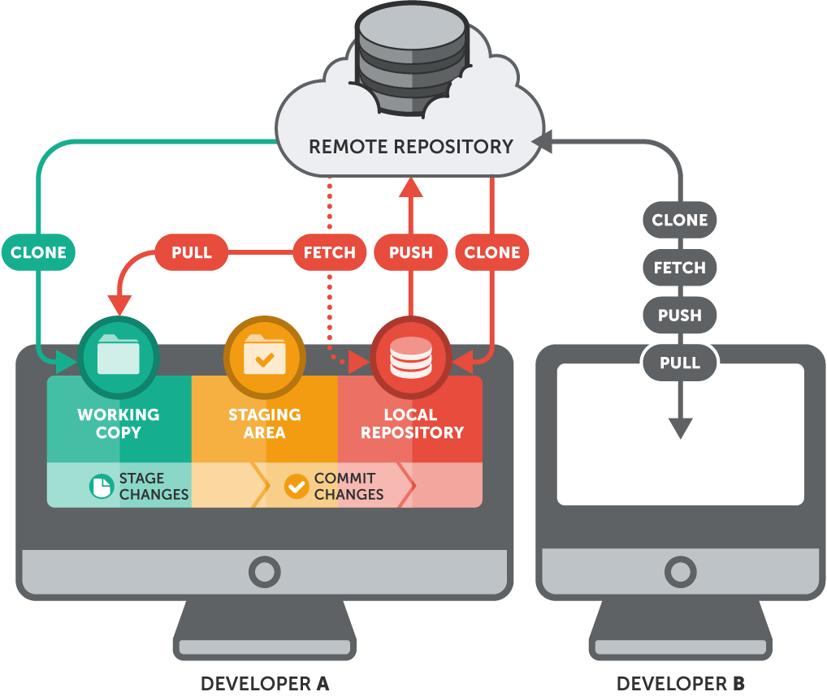
Git with multiple developers
Source: https://gist.github.com/dirkdunn/2ff2784e8c780f0f7c2cc2a909fc299c

Slide 21
Branch
When to branch for?
develop a new feature (branch “webgui-ninja-branch”)
bug fix (branch “bug-12345-branch”)
refactor (branch “b2b-autotest-branch”)
whatever experiments

Slide 22
Branch (continued)
Resolve
decide the final result to be committed when conflicts happen
Branch
make a copy of the whole project to be developed in parallel
Merge
propagate the changes in one branch to another branch

Slide 23
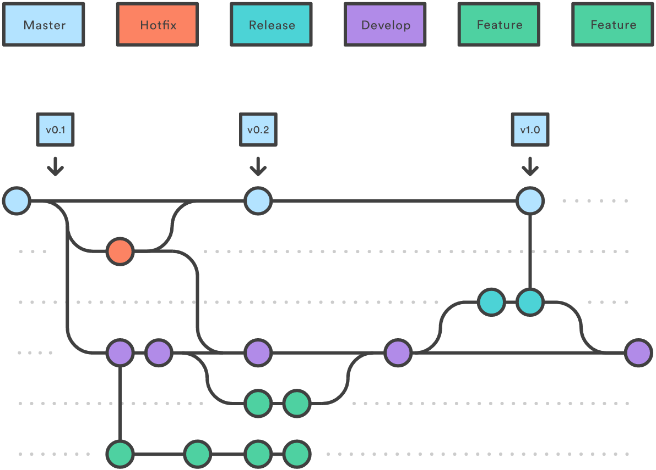
Branch(分支)
fork
merge
Source: http://i.stack.imgur.com/TBHkD.png

Slide 24

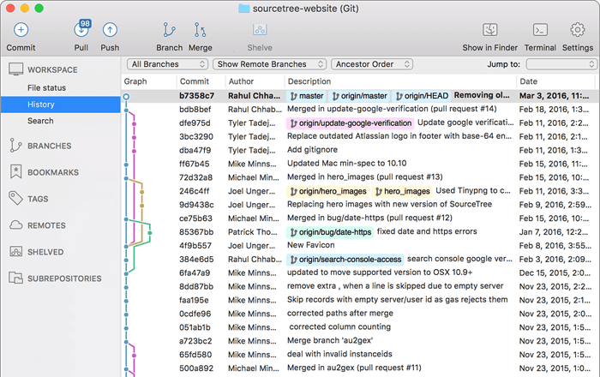
Sourcetree: A free Git GUI client
Source: https://www.sourcetreeapp.com/

Slide 25
Version Control in Practices
Version control all artifacts of your project, including documents and unit tests
Write summary comments in each commit so others can see why you make the change without looking at the code
Use branches for feature development in parallel and merge the branches back to trunk after development completes
Integrate your version control system with bug tracking and other project management systems
e.g. Bug #12345 is fixed in revision #200001. You can cross reference the bug information or revision from the either system

Slide 26
Q & A
Q & A

